Slide 1
Project Irregular
Implementing an Information System for Reporting Cases of Missing, Abducted, Runaway, Throwaway, Found and Unidentified Persons
Rey Vincent Babilonia

Slide 2
Outline
Statement of the Problem
Background and Objectives of the Project
Documentation of Existence and Seriousness of the Problem
Demonstration
Recommendations

Slide 3
Statement of the Problem
Lack of a centralized service for disseminating advisories on missing persons to the public
Need for a joint effort in finding missing Filipinos
Absence of a free and open source Information System for reporting missing persons

Slide 4
Background and Objectives of the Project
Integrate Information System with High-Performance Computing
  Age Progression
  Missing Persons Information System

Slide 5
Background and Objectives of the Project
SB 429: Commission on Missing Persons
  Senator Jinggoy Estrada
  Filed on July 2, 2007
  Pending as of August 14, 2007
  Chairman of the CHR, the Director General of the PNP, the Director of the NBI, the Chairman of the NAPOLCOM, the Secretary of DSWD and 2 members from the private sector whose advocacy is on human rights

Slide 6
Background and Objectives of the Project
SB 1709: Missing Persons Council
  Senator Manny Villar
  Filed on October 8, 2007
  Pending as of November 5, 2007
  Secretary of DOJ, the Chairman of CHR, the Chief of PNP, the Director of NBI and the Secretary of DSWD

Slide 7
Background and Objectives of the Project
SB 1385: National Strategic Missing Children Recovery Program
  Senator Loren Legarda

Slide 8
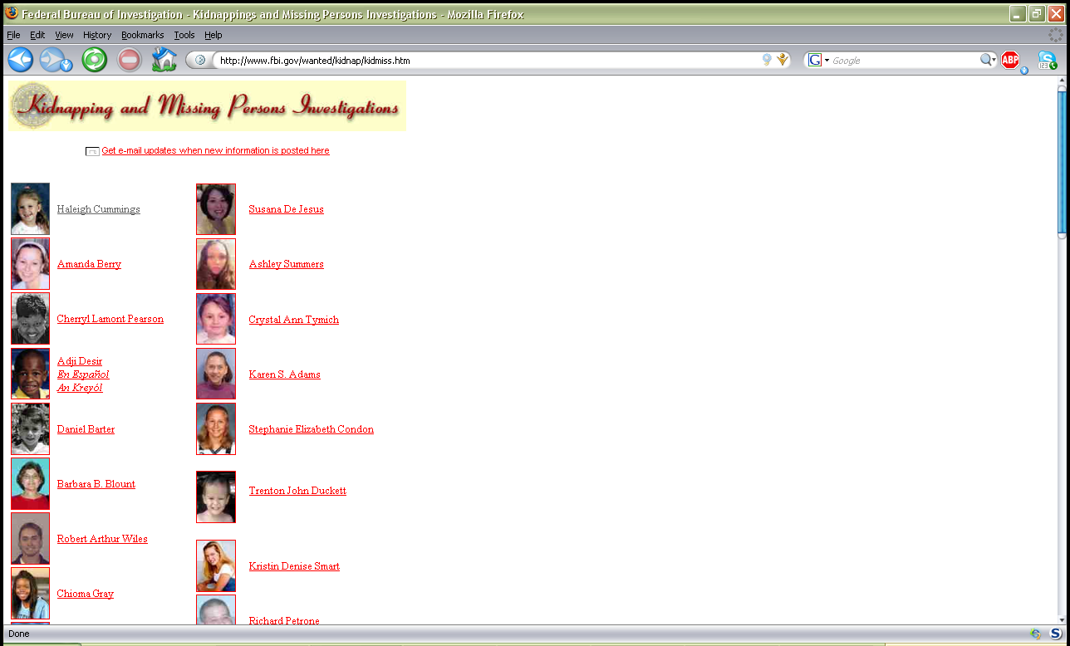
Background and Objectives of the Project
Federal Bureau of Investigation (US)

Slide 9
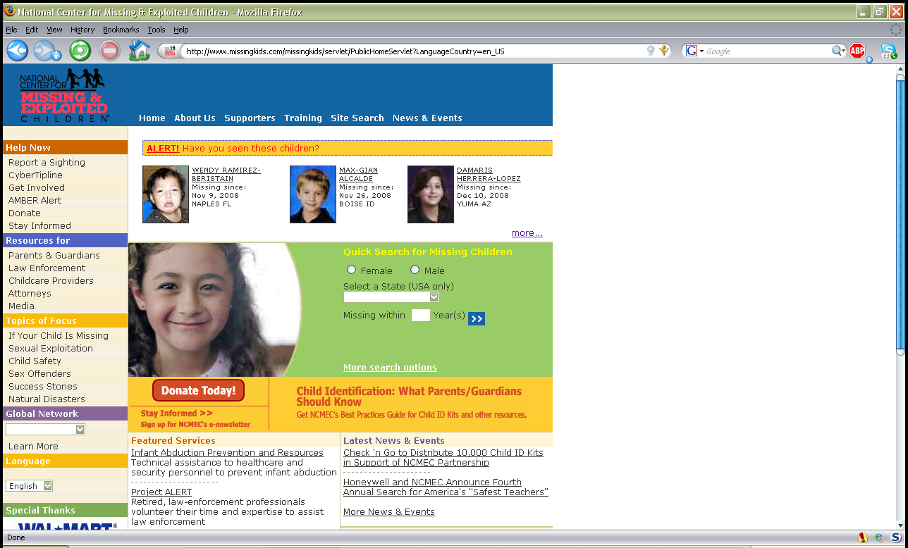
Background and Objectives of the Project
National Center for Missing and Exploited Children (US)

Slide 10
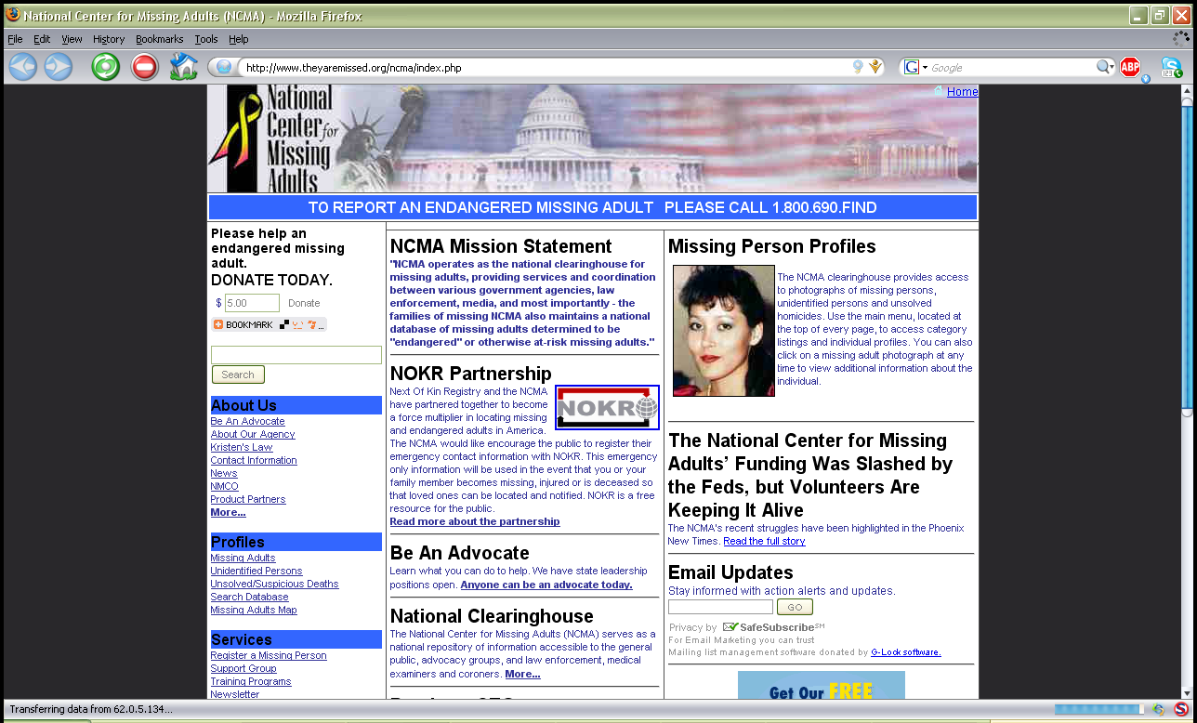
Background and Objectives of the Project
National Center for Missing Adults (US)

Slide 11
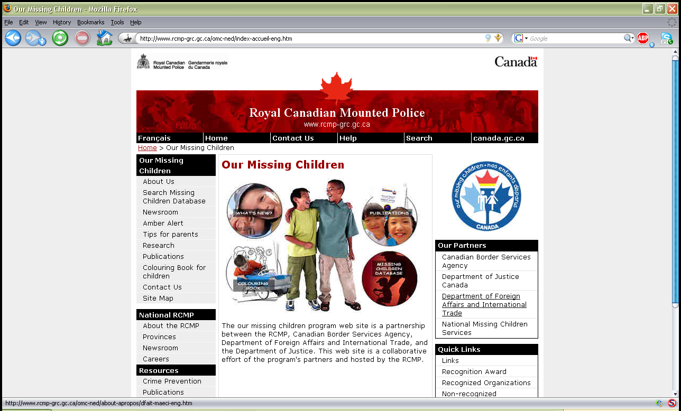
Background and Objectives of the Project
National Missing Children Services (Canada)

Slide 12
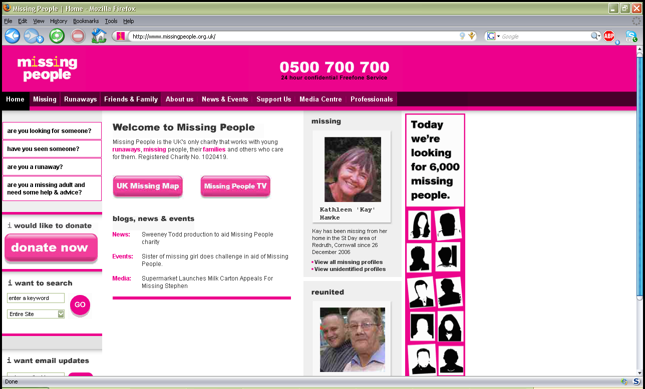
Background and Objectives of the Project
Missing People (UK)

Slide 13
Background and Objectives of the Project
Aim: Information System
  that will integrate and consolidate all government efforts in finding missing, abducted and runaway persons and reporting throwaway, abandoned, found and unidentified persons
  that will inform and encourage citizens to look out for these missing persons
  that will promote awareness for the public in keeping their relatives safe

Slide 14
Documentation of Existence and Seriousness of the Problem
Chalana or FindThem
  http://sourceforge.net/project/chalana
  http://sourceforge.net/project/findthem
  free and open source missing persons information system from Sri Lanka
  still under development

Slide 15
Documentation of Existence and Seriousness of the Problem
Mass Casualty Disaster Data Collection
  http://sourceforge.net/project/pcrx911
  free and open source disaster management system
  still under development

Slide 16
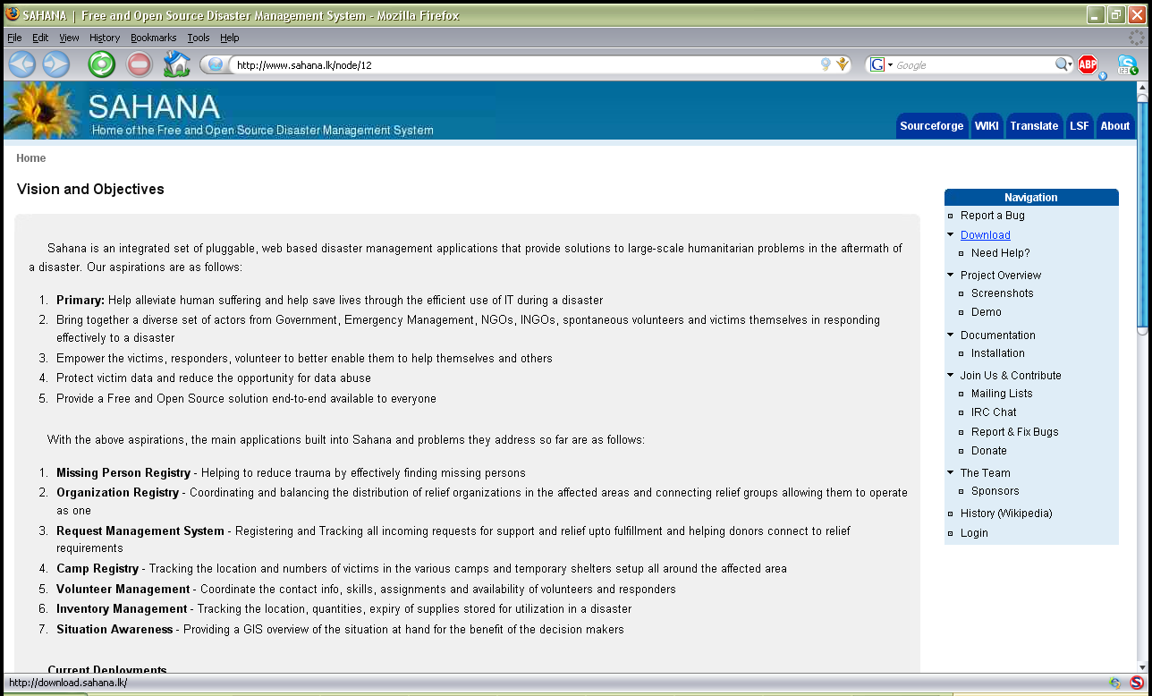
Documentation of Existence and Seriousness of the Problem
Sahana
  http://www.sahana.lk
  free and open source disaster management system from Sri Lanka
  simple submodule for missing persons

Slide 17
Documentation of Existence and Seriousness of the Problem
The Web sites of NBI, PNP and DSWD do not have a list of missing persons
Statistical data relevant to proving the existence and seriousness of the identified problems are not available because NBI, PNP and DSWD have not published any

Slide 18
Documentation of Existence and Seriousness of the Problem
KARAPATAN
  human rights advocacy group
  counts 196 enforced disappearances under the Arroyo administration (Philippine Senate, 2007)

Slide 19

Documentation of Existence and Seriousness of the Problem
Matthew Samudio
  3 yrs old
  Putatan, Muntinlupa
  Abducted on July 22, 2008 (Festival Mall, Alabang)
  Used by a syndicate to beg in the markets of Sta. Rosa, Laguna

Slide 20
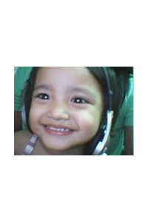
Documentation of Existence and Seriousness of the Problem
Ma. Ysabelle Sim
  2 yrs old
  Pandacan, Manila
  Snatched on November 23, 2006
  Featured in Jessica Soho's “Sana'y Muling Makapiling (Reunions)” on QTV
  Sold to a childless couple in Surigao del Sur

Slide 21

Documentation of Existence and Seriousness of the Problem
Sherry Ann Salac
  23 yrs old
  Left house in Tonsuya, Malabon on May 20, 2007 without telling anyone where she's going
  Did not run away for she did not bring any of her belongings

Slide 22
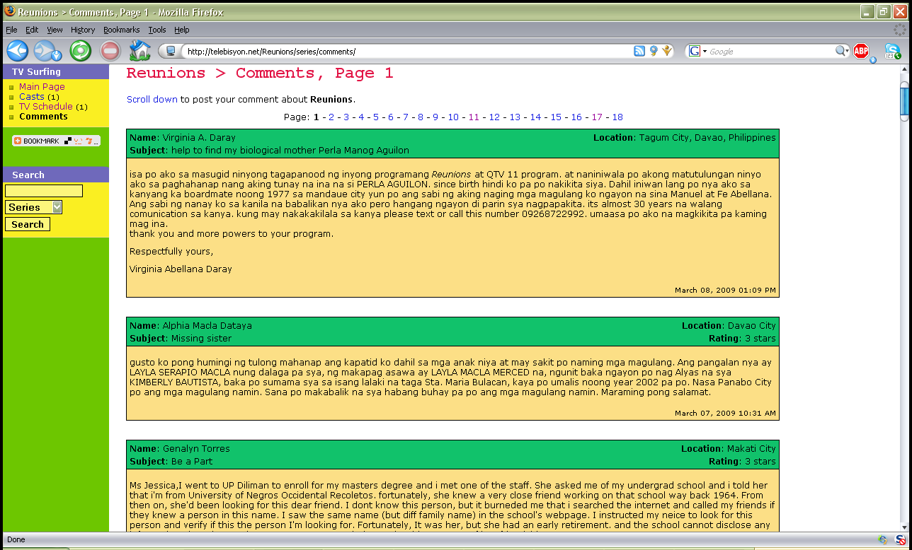
Documentation of Existence and Seriousness of the Problem
www.telebisyon.net

Slide 23
Demonstration
http://localhost:8084/openmpis/

Slide 24
Recommendations
A theme highlighting Philippine culture can be used for the locally-deployed version
A Tagalized version of texts can be drafted
Access to support groups can be integrated into the system
Contacting those who have a missing a loved one and asking them to file a missing person report using the Case Reporting Form

Slide 25
Recommendations
Pursue funding for the continued improvement and eventual nationwide deployment of the system (DOST-PCASTRD)
A Geographic Information System can be added on the next major upgrade which can pinpoint the locations where persons disappeared. Statistical data can be overlaid on a Google map to create a visualization of reported cases

Slide 26
Recommendations
Forwarding of advisories through multimedia messages in cellular phones, although expensive, can be fast and effective. Mobile services can be explored on succeeding versions
A study on how to set up additional servers and load balancer can be undertaken
OpenMPIS can still be expounded in another paper as a case study on GST

Slide 27
Recommendations
The age progression module may be available within the next five years. A high-performance computing cluster; Java 2D API and mpiJava or MPJ Express libraries for the software; and hundreds of pictures of Filipinos from various age groups will be utilized

Slide 28
Thank you very much!
“Education never ends, Watson. It is a series of lessons with the greatest at the last.”
- Sherlock Holmes in The Adventure of the Red Circle

